Slide 1
Infection Prevention
“Be Aware of the Danger but Recognize the Opportunity!”
JoAnn Adkins, BSN, RN, CIC, LTC-CIP, FAPIC
Infection Prevention Advisor
Patient Safety Authority

Slide 2
Objectives
Explain how drug resistance develops and review the high risk, easily transmittable organisms that may be encountered in LTC
Identify the core elements of an antibiotic stewardship plan
Identify ways to minimize exposure and describe the types of transmission-based precautions
Recognize the importance of early recognition of infection for resident and healthcare worker safety and well-being
Notes:
To break the chain of transmission of disease in facilities, it is important to follow infection prevention principles. This presentation will discuss the ways to minimize exposure to pathogens and review the various types of transmission-based precautions.

Slide 3
Objectives
Explain how drug resistance develops and review the high risk, easily transmittable organisms that may be encountered in LTC
Identify the core elements of an antibiotic stewardship plan
Identify ways to minimize exposure and describe the types of transmission-based precautions
Recognize the importance of early recognition of infection for resident and healthcare worker safety and well-being
Notes:
To break the chain of transmission of disease in facilities, it is important to follow infection prevention principles. This presentation will discuss the ways to minimize exposure to pathogens and review the various types of transmission-based precautions.

Slide 4

Antimicrobial Resistance

Slide 5
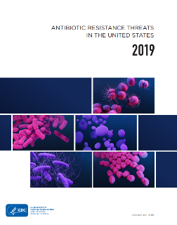
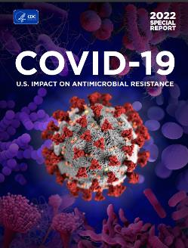
Antimicrobial Resistance Progress
CDC Antibiotic Resistance Threats Report showed that from 2012-2017 overall 18% decrease of death from antimicrobial-resistant infections
CDC’s 2022 special report found that much of that progress is lost
CDC: National Estimates for Antibiotic Resistance
Notes:
In 2019, CDC’s 2019 AR Threats Report noted that dedicated prevention and infection control efforts in the U.S. reduced deaths from antimicrobial-resistant infections by 18% overall and by nearly 30% in hospitals. However, CDC’s 2022 special report highlighting the impact of COVID-19 on antimicrobial resistance in the U.S. found that much of that progress was lost, in large part, due to the effects of the pandemic.

Slide 6
Urgent Global Public Health Threat
2019 Data:
  1.27 million deaths worldwide
  >2.8 million antimicrobial-resistant infections each year in the US
  >35,000 deaths in the US
CDC: National Estimates for Antibiotic Resistance
Notes:
Read slide
It is important to understand how drug resistance occurs. I’m going to review the many ways organisms can become resistant to antimicrobials

Slide 7
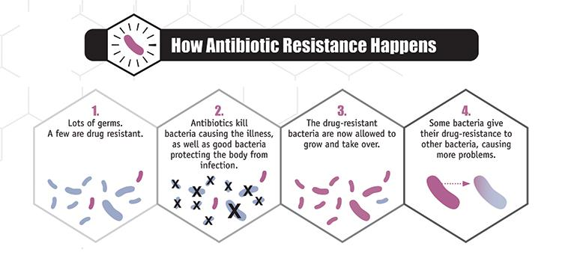
How Does Resistance Happen?
CDC
Notes:
We have reviewed this previously during this webinar series, but to quickly review or for anyone who has missed previous webinars….

Slide 8
Types of Resistance Mechanisms
Altered target site
Drug inactivation
Bypass
Decreased Permeability or Efflux
Restrict Access
Arnold FW: APIC Text, CDC: How Antibiotic Resistance Happens
Notes:
Altered target site
Antimicrobials single out and destroy specific targets on the organism
Organisms can change the target, so the drug can no longer fit and do its job
Example:
MRSA- Penicillin-binding protein (PBP) is altered to PBP2a
E. coli- mcr-1 gene adds a compound to the cell wall so colistin cannot latch
Aspergillus fumigatus- cyp1A gene is changed so triazoles can’t bind to the protein
Drug inactivation
Production of an enzyme which destroys or inactivates the antimicrobial
Example:
Klebsiella pneumoniae- produce carbapenemases/β-lactamase enzymes that break down carbapenem drugs and most other beta-lactam drugs
Bypass
Development of alternate metabolic pathways which bypass the pathway or target of the antimicrobial
Example:
Staphylococcus aureus- some can bypass the effects of trimethoprim/sulfamethoxazole
Decreased permeability or efflux
Organisms can get rid of antimicrobials through the use of pumps in cells walls
Removes the drug from the cell once it enters
Example:
Pseudomonas aeruginosa- can produce pumps to get rid of fluoroquinolones, beta-lactams, chloramphenicol and trimethoprim
Candida- some species can produce pumps to get rid of azoles such as fluconazole
Restrict access
Organisms can change entryways or limit the number of entryways
Example:
Gram-negative bacteria- outer layer or membrane which can be used to selectively keep antibiotic from entering

Slide 9
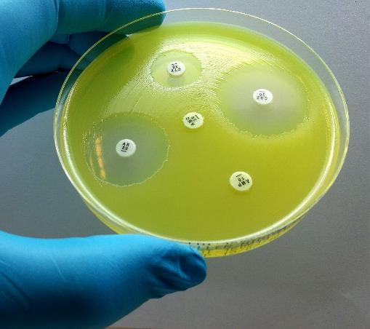
Development of Antimicrobial Resistance
Point mutations in existing genes
Acquisition of new genes
Arnold FW: APIC Text
Notes:
Point mutations are random errors that occur during DNA replication, resulting in the substitution of one base pair for another, which may result in the substitution of one amino acid for another in a protein structure or enzyme. These mutations occur infrequently at the correct locations of the bacterial genome necessary to cause resistance (10⁷ to 10¹² per generation); when point mutations are responsible for resistance, it usually is because they have a slight structural change in a drug receptor or target site. However, because most forms of antimicrobial resistance require complex structural or enzymatic changes, most forms of resistance result from newly acquired genes.

Slide 10
Mobile Genetic Elements
Notes:
Resistance in organisms can be inherited and passed down generation to generation or they can be passed directly from one organisms to another through mobile genetic elements

Slide 11
Mobile Genetic Elements

Slide 12
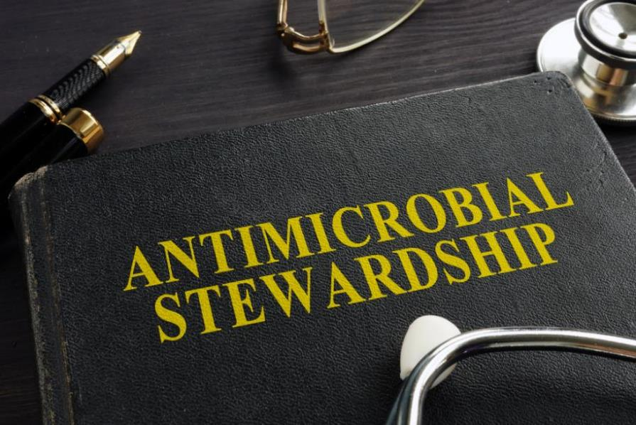

Slide 13
What is Antibiotic Stewardship?
Process of coordinated interventions:
  Change the way antibiotics are used
  Improves and measures the appropriate use of antimicrobial agents
Shared commitment:
  Always use antibiotics appropriately and safely
  Use only when needed to treat disease
  Choose right drug, dose, duration
(APIC, CDC)
Notes:
Perhaps the single most important action needed to greatly slow down the development and spread of antibiotic-resistant infections is to change the way antibiotics are used.
READ SLIDE –
Stopping even some of the inappropriate and unnecessary use of antibiotics would help greatly in slowing down the spread of resistant bacteria.

Slide 14
Goals and Rationale for Stewardship
Optimal Use
Suboptimal Use
Increases infection cures
Improves pathogen susceptibility profiles
Reduces adverse effects of antibiotics
Increases appropriate, cost-effective prescribing for therapy and prophylaxis
Increases treatment failures
Increases morbidity, mortality, hospitalization
Increases adverse effects of antibiotics
Higher costs for treatment
(APIC, CDC)

Slide 15
Diagnosis
Drug
Dose
Duration
De-escalation
Notes:
Remember the 5 D’s of optimal antimicrobial therapy
Diagnosis Does the condition require antibiotic therapy? Drug Is the bacteria susceptible? Dose What is the recommended dose? Duration What is the recommended duration? De-escalation Can the antibiotic be switched from IV to oral?

Slide 16
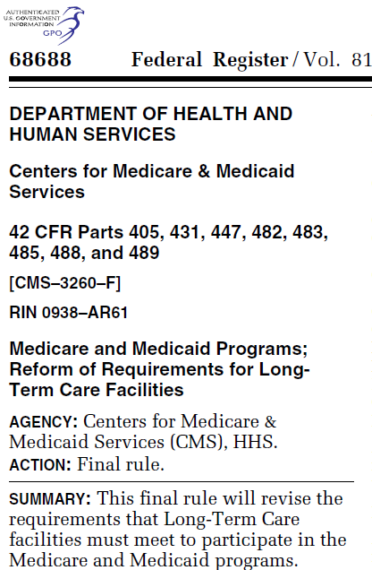
CMS Long-Term Care Final Rule
Effective November 28, 2017
42 CFR part § 483.80 Infection Control Phase 2
Infection Prevention & Control Program (IPCP) includes:
  Antibiotic stewardship program
  Antibiotic use protocols
  System to monitor antibiotic use
(CMS)
Notes:
The national action plan filters down to the state and individual LTCF level
Dept. HHS- CMS – published Federal Register Oct. 4, 2016
Updates all nursing home requirements including the IC section.
New terminology-
READ SLIDE
The Centers for Medicare & Medicaid Services (CMS) published a final rule titled Medicare and Medicaid Programs; Reform of Requirements for Long-Term Care Facilities on October 4, 2016. The final rule requires an antibiotic stewardship program that includes antibiotic use protocols and systems for monitoring antibiotic use and recording incidents identified under the facility’s infection prevention and control program (IPCP) and the corrective actions taken by the facility.

Slide 17
What Does Antimicrobial Stewardship Look Like?
Standardized process for eliciting information and communicating a change in resident condition from nursing assistants to nurses
Standardized processes for communicating clinical information from nurses to providers
Standardized protocols for lab testing
Standardized treatment algorithms
Evidence-based recommendations
Processes must work in the facility
(CDC)
Notes:
What Does Antimicrobial Stewardship Look Like?
Standardized process for eliciting information and communicating a change in resident condition from nursing assistants to nurses • Standardized processes for communicating clinical information from nurses to providers • Standardized protocols for lab testing • Standardized treatment algorithms • Evidence-based recommendations (ex: Loeb, 2001) • Processes must work in the facility • Start small; trial and error will determine what fits for the facility • Integrate into existing systems

Slide 18
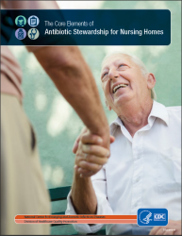
CDC Core Elements
Leadership commitment and accountability
Drug expertise
Specific actions to change policy and practice
Track and report antibiotic use
Education
(CDC)
Notes:
The core elements of a stewardship plan goes far beyond just writing a plan. The CDC has identified the following as necessary to a successful antibiotic stewardship program.
READ SLIDE
Here is a summary of the core elements for antibiotic stewardship in nursing homes:
Leadership commitment:
Demonstrate support and commitment to safe and appropriate antibiotic use in your facility.
Accountability:
Identify physician, nursing, and pharmacy leads responsible for promoting and overseeing antibiotic stewardship activities in your facility.
Drug expertise:
Establish access to consultant pharmacists or other individuals with experience or training in antibiotic stewardship for your facility.
Action:
Implement at least one policy or practice to improve antibiotic use.
Tracking:
Monitor at least one process measure of antibiotic use and at least one outcome from antibiotic use in your facility.
Reporting:
Provide regular feedback on antibiotic use and resistance to prescribing clinicians, nursing staff, and other relevant staff.
Education:
Provide resources to clinicians, nursing staff, residents, and families about antibiotic resistance and opportunities for improving antibiotic use.

Slide 19
Key Points of Stewardship
Avoid using antibiotics when a bacterial infection is unlikely.
Obtain appropriate cultures and other testing when indicated
Select empiric therapy based on likely pathogens
Determine appropriate dose and duration
Re-evaluate within 48-72 hours, Time-out
Switch from IV to oral therapy
Treat with the shortest duration of therapy
Notes:
The following topics will be covered in this AS series. (Read slide)
Avoid using antibiotics when bacterial infection is unlikely. Learn to recognize colonization and contamination in cultures and other etiologies of false positive diagnostic tests. Choose carefully when to send a diagnostic test for infection.
Obtain appropriate cultures and other diagnostic testing when indicated.
Select empiric antimicrobial therapy based on likely pathogens, using an antibiogram for guidance.
Determine appropriate dose based on site and severity of infection, using BCH Empiric Antimicrobial Therapy Guidelines and Dosing Guidelines, or Lexi-Comp.
Within 48-72 hours, re-evaluate therapy to target the likely diagnosis, and when available, based on culture and susceptibility data.
If a specific source or pathogen is not identified it is recommended to de-escalate therapy in most circumstances
Discontinue antimicrobials when an indication no longer exists (e.g. vancomycin if cultures do not show MRSA).
Use the narrowest regimen likely to be effective.
Switch from IV to enteral therapy as soon as it is clinically appropriate.
Treat with the shortest duration of therapy that is likely to be effective for the presumed or proven infection.
The next webinar will be held on Thursday, March 9th at 1230 and will discuss the types of Antimicrobials (Christine)
A. Antibacterials
B. Antivirals
C. Antifungal

Slide 20
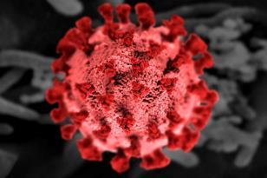

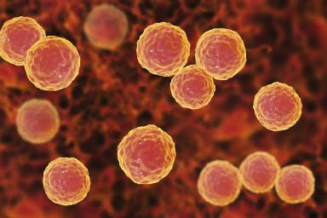
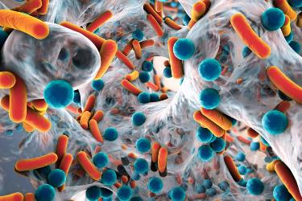
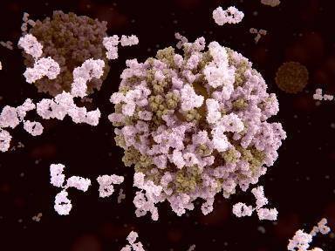
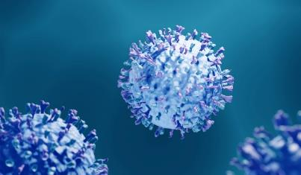
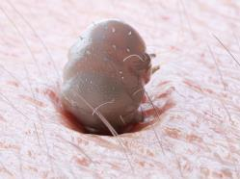
Clinically Significant Organisms

Slide 21
Clinically Significant Organisms
Multidrug-resistant organisms:
  MRSA (methicillin-resistant Staphylococcus aureus
  VRSA/VISA (Vancomycin-resistant Staphylococcus aureus and Vancomycin-intermediate Staphylococcus aureus)
  VRE (vancomycin-resistant enterococcus))
  C. diff (Clostridioides difficile)
  CRO (carbapenem-resistant organisms)
  ESBL (extended spectrum beta-lactamases)
  Candida auris
Influenza
COVID-19
Respiratory Syncytial Virus (RSV)
Norovirus
Scabies
iGAS
Notes:
The CDC developed a listing of organisms ranks by their threat to public health. I am going to focus on the MDROs seen in PA facilities and other high risk organisms easily transmitted in LTC facilities or capable of triggering an outbreak.

Slide 22
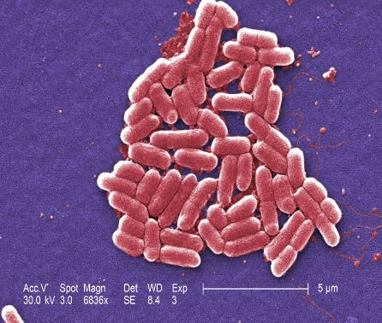
Multi-drug Resistant Organisms (MDROs)
Organisms:
  MRSA (methicillin-resistant Staphylococcus aureus
  Vancomycin-resistant Staphylococcus aureus
  VRE (vancomycin-resistant enterococcus)
  Clostridioides difficile
  CRO (carbapenem-resistant organisms)
  ESBL (extended spectrum beta-lactamases)
  Candida auris
Resistant to multiple antimicrobials
Can cause severe infections and even death
CDC: Antibiotic Resistance Threats in the United States, 2019

Slide 23
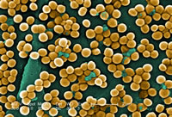
Methicillin-resistant Staphylococcus aureus (MRSA)
Bacteria resistant to several antibiotics
Staphylococcus aureus is a normal skin flora
Healthcare-associated and Community associated
In the outpatient setting is often a skin infection
In LTC can cause serious infections:
  Bloodstream
  Pneumonia
  Skin and soft tissue
  Surgical site
  Sepsis
CDC: Antibiotic Resistance Threats in the United States, 2019
Notes:
Methicillin-resistant Staphylococcus aureus (MRSA) infection is caused by a type of staph bacteria that's become resistant to many of the antibiotics used to treat ordinary staph infections.
Listed by CDC as serious threat
Most methicillin-resistant Staphylococcus aureus (MRSA) infections occur in people who've been in hospitals or other health care settings, such as nursing homes and dialysis centers. When it occurs in these settings, it's known as health care-associated (HA-MRSA). health care-associated methicillin-resistant Staphylococcus aureus (HA-MRSA) infections usually are associated with invasive procedures or devices, such as surgeries, intravenous tubing or artificial joints. HA-MRSA can spread by health care workers touching people with unclean hands or people touching unclean surfaces.
Another type of infection has occurred in the wider community — among healthy people. This form, community-associated (CA-MRSA), often begins as a painful skin boil. It's usually spread by skin-to-skin contact. At-risk populations include groups such as high school wrestlers, child care workers and people who live in crowded conditions.
MRSA stands for methicillin-resistant Staphylococcus aureus, a type of bacteria that is resistant to several antibiotics.
Two categories of MRSA are:
Hospital-associated (HA): HA-MRSA refers to MRSA infections that are associated with healthcare settings, such as hospitals and nursing homes.
Community-associated (CA): CA-MRSA infections are those that occur in people who have not had a recent hospitalization or other contact with the healthcare system.
Outpatient Settings
In the community (where you live, work, shop, and go to school), MRSA most often causes skin infections. In some cases, it causes pneumonia (lung infection) and other infections. If left untreated, MRSA infections can become severe and cause sepsis—the body’s extreme response to an infection.
In Healthcare Settings
In places such as a hospital or nursing home, MRSA can cause severe problems such as bloodstream infections, pneumonia, or surgical site infections.

Slide 24
Vancomycin-intermediate and Vancomycin-resistant Staphylococcus aureus (VISA/VRSA)
Staphylococcus aureus bacteria that is resistant to vancomycin
Only 14 cases identified in US since 2002
Transmission from patient to patient has not been documented
All isolates have been susceptible to other antibiotics
VRSA listed as concerning by CDC in 2013. Removed as threat in 2019.
CDC continues to monitor
CDC: Antibiotic Resistance Threats in the United States, 2019
Notes:
General Information about VISA/VRSA
Vancomycin [van−kō−mī−sin]-intermediate Staphylococcus aureus [staff−u−lu−kaw−kus aw−ree−us] (also called VISA) and Vancomycin-resistant Staphylococcus aureus (also called VRSA) are specific types of antimicrobial-resistant bacteria. However, as of October 2010, all VISA and VRSA isolates have been susceptible to other Food and Drug Administration (FDA)-approved drugs. Persons who develop this type of staph infection may have underlying health conditions (such as diabetes and kidney disease), tubes going into their bodies (such as catheters), previous infections with methicillin-resistant Staphylococcus aureus (MRSA), and recent exposure to vancomycin and other antimicrobial agents.
Vancomycin-resistant Staphylococcus aureus (VRSA) Listed as Concerning in 2013. Removed as a threat in 2019. Since 2002, 14 cases of VRSA have been identified in the United States. These are isolated cases and spread from patient to patient has never been documented. CDC removed VRSA as a threat and will continue monitoring it as part of ongoing work to reduce Staphylococcus infections in health care and the community.
A vancomycin resistant staphylococcus aureus (VRSA) infection is caused by bacteria. These bacteria are resistant to the antibiotic medicine vancomycin.

Slide 25
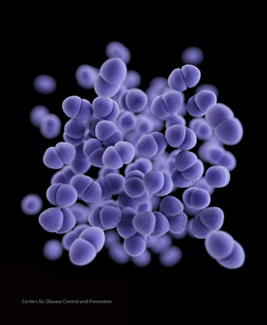
Vancomycin-resistant Enterococcus (VRE)
Enterococci are normal flora of GI tract
VRE are strains resistant to the antibiotic vancomycin
First reported in1989 in US, rapidly spread through healthcare facilities
CDC: Antibiotic Resistance Threats in the United States, 2019
Notes:
Enterococci are germs that live in the gastrointestinal tract (bowels) of most individuals and generally do not cause harm (this is termed “colonization”). Vancomycin-resistant enterococci (VRE) are strains of enterococci that are resistant to the antibiotic vancomycin. If a person has an infection caused by VRE, such as a urinary tract infection or blood infection, it may be more difficult to treat.
Colonizes in the intestinal tract

Slide 26
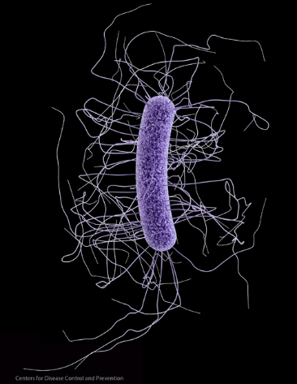
Clostridioides difficile (C-difficile, C. diff)
Gram-positive, obligate, spore-forming anaerobe bacteria
Common bacteria responsible for infections in hospitals
Causes almost half a million infections in the United States each year
About 1 in 6 patients who get C. diff will get it again in the subsequent 2-8 weeks.
One in 11 people over age 65 diagnosed with healthcare-associated C. diff infection die within one month.
CDC: Antibiotic Resistance Threats in the United States, 2019
Notes:
Clostridioides difficile (klos-TRID-e-oi-deez dif-uh-SEEL) is a bacterium that causes an infection of the large intestine (colon). Symptoms can range from diarrhea to life-threatening damage to the colon. The bacterium is often referred to as C. difficile or C. diff. Illness from C. difficile typically occurs after use of
Causes up to ¼ of antibiotic associated diarrhea. The spores are responsible for the persistence of C diff in patients and horizontal transmission between hospitalized patients.
C. difficile causes immense suffering and death.
Risks for developing c. diff infection and death has increased with age in every setting.
2/3 pf c. diff infections are in people 65+. Older people at higher risk for death.
Community acquired c diff has increased significantly over the past decade.

Slide 27
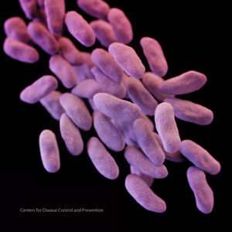
Carbapenem-resistant Enterobacterales (CRE)
Enterobacterales are a bacteria commonly found in GI tract
Listed as an urgent threat by CDC
Very concerning as carbapenems are usually the last drug option for the treatment of MDRO infections
Associated with mortality rates of up to 50% for hospitalized patients
Carbapenemase-producing CRE (CP-CRE) believed to be responsible for the increasing spread
CDC: Antibiotic Resistance Threats in the United States, 2019
Notes:
CRE stands for carbapenem-resistant Enterobacterales. Enterobacterales are an order of bacteria commonly found in people’s gastrointestinal tract that can cause infections both in healthcare and community settings.
All CRE are likely multidrug-resistant organisms and interventions might be required in healthcare settings to prevent transmission. However, a subset of CRE, called carbapenemase-producing CRE (CP-CRE), are currently believed to be primarily responsible for the increasing spread of CRE in the United States and have therefore been targeted for aggressive prevention.
Carbapenem-resistant Acinetobacter Listed as Serious (as Multidrug-resistant Acinetobacter) in 2013. Listed as Urgent in 2019. Acinetobacter often causes infections in people who have weakened immune systems, such as hospitalized or very sick patients. The previous report measured and listed this germ as multidrug-resistant Acinetobacter, but the 2019 report focuses on carbapenem resistant Acinetobacter, which is often resistant to many antibiotics. The threat level was escalated to Urgent because of the emergence of easily spread resistance in Acinetobacter and the lack of current antibiotics, and antibiotics in development, to treat these infections.
Enterobacterales are a large order of different types of germs (bacteria) that commonly cause infections in healthcare settings. Examples of germs in the Enterobacterales order include Escherichia coli (E. coli) and Klebsiella pneumoniae.
Antibiotic resistance occurs when the germs no longer respond to the antibiotics designed to kill them. Enterobacterales bacteria are constantly finding new ways to avoid the effects of the antibiotics used to treat the infections they cause.
When Enterobacterales develop resistance to the group of antibiotics called carbapenems, the germs are called carbapenem-resistant Enterobacterales (CRE).
CRE are difficult to treat because they do not respond to commonly used antibiotics. Occasionally CRE are resistant to all available antibiotics. CRE are a threat to public health.
Why are CP-CRE considered epidemiologically important?
Learn More about CRE in the United States
Read CDC’s report
Antibiotic Resistance Threats in the United States, 2019
CRE organisms are often resistant to multiple classes of antibiotics, substantially limiting treatment options.
Infections caused by these organisms are associated with high mortality rates among hospitalized patients, up to 50% in some studies.
Many CRE produce carbapenemases, which can be transmitted from Enterobacterales to other germs, facilitating spread of resistance.
Enterobacterales are a common cause of infections in both community and healthcare settings. Although CRE is currently primarily associated with inpatient healthcare settings, it has the potential to spread to community settings.
For these reasons, CDC has developed resources to support healthcare providers as they screen patients for CRE and take action to decrease transmission of CRE.

Slide 28
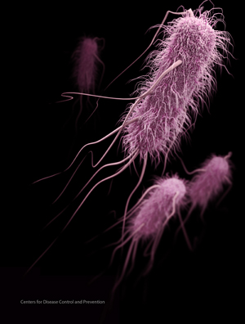
Extended Spectrum Beta-lactamase Producing Organisms
(ESBL)
Enterobacterales are a bacteria commonly found in GI tract
Some Enterobacterales produce ESBLs that break down and destroy commonly used antibiotics
Common infections caused by these organisms require more complex treatment
In 2017, approximately 197,400 cases of ESBL infections in hospitalized patients and approximately 9,100 deaths
CDC: Antibiotic Resistance Threats in the United States, 2019
Notes:
Enterobacterales are a large order of different types of bacteria (germs) that commonly cause infections both in healthcare settings and in communities. Examples of germs in the Enterobacterales order include Escherichia coli (E. coli) and Klebsiella pneumoniae.
To survive the effects of antibiotics, germs are constantly finding new defense strategies, called “resistance mechanisms.” For example, some Enterobacterales can produce enzymes called extended-spectrum beta-lactamases (ESBLs). ESBL enzymes break down and destroy some commonly used antibiotics, including penicillins and cephalosporins, and make these drugs ineffective for treating infections.
Learn about CRE
Carbapenem-resistant Enterobacterales (CRE)
This resistance means that there are fewer antibiotic options available to treat ESBL-producing Enterobacterales infections. In many cases, even common infections, such as urinary tract infections, caused by ESBL-producing germs require more complex treatments. Instead of taking oral antibiotics at home, patients with these infections might require hospitalization and intravenous (IV) carbapenem antibiotics.
See CDC’s report
Antibiotic Resistance Threats in the United States, 2019
In 2017, there were an estimated 197,400 cases of ESBL-producing Enterobacterales among hospitalized patients and 9,100 estimated deaths in the United States
Carbapenems are one of the few remaining antibiotics that can treat ESBL-producing germs, but resistance enzymes that destroy these antibiotics are on the rise, too. The more we rely on this important class of antibiotics, the greater the risk of spreading resistance to them.

Slide 29

Candida auris (C. auris)
Type of yeast that spreads easily among patients and residents
Can cause severe illness and death
Often multi-drug resistant with some strains resistant to all available classes of antifungals
Difficult to identify with standard laboratory methods
Has caused outbreaks in facilities
CDC: Antibiotic Resistance Threats in the United States, 2019
Notes:
C. auris
Not listed in 2013. Listed as Urgent in 2019. C. auris emerged after the 2013 report was published. It is a multidrug-resistant yeast that can cause invasive infection and death. It
spreads easily between hospitalized patients and nursing home residents. Particularly concerning, some strains (types) of C. auris are resistant to all three antibiotic classes used to treat fungal infections.
Candida auris is an emerging fungus that presents a serious global health threat. Candida auris (C. auris) is a type of yeast that can cause severe illness and spreads easily among patients in healthcare facilities. It is often resistant to antifungal treatments, which means that the medications that are designed to kill the fungus and stop infections do not work.
CDC is concerned about C. auris for three main reasons:
It is often multidrug-resistant, meaning that it is resistant to multiple antifungal drugs commonly used to treat Candida infections. Some strains are resistant to all three available classes of antifungals.
It is difficult to identify with standard laboratory methods, and it can be misidentified in labs without specific technology. Misidentification may lead to inappropriate management.
It has caused outbreaks in healthcare settings. For this reason, it is important to quickly identify C. auris in a hospitalized patient so that healthcare facilities can take special precautions to stop its spread.

Slide 30
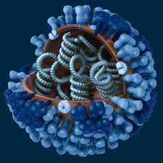
Influenza
Highly infectious viral illness, commonly called the “flu”
One of the most common infectious diseases of birds and mammals
Secondary bacterial pneumonia most common complication
One of the ten leading causes of death in the US when combined with pneumonia
Influenza viruses are unique in their ability to cause both recurrent annual epidemics and more serious pandemics
CDC: Influenza (flu)
Notes:
One of the most common infectious disease of birds and mammals
Single strand RNA virus of the Orthomyxoviridae family
Influenza viruses are unique in their ability to cause both recurrent annual epidemics and more serious pandemics
One of the 10 leading causes of death in the US when combined with pneumonia

Slide 31
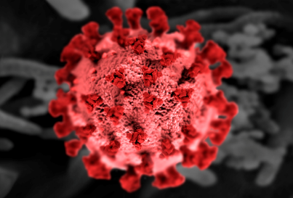
Coronavirus Disease 2019 (COVID – 19)
Caused by SARS-CoV-2 virus
Very contagious and spreads quickly
Viruses mutate frequently leading to new strains or variants of the virus
Infected people may be asymptomatic, have mild illness or develop severe illness
Elderly, immunocompromised individuals, or people with certain health conditions are at higher risk of developing severe illness
CDC: About COVID-19
Notes:
COVID-19 (coronavirus disease 2019) is a disease caused by a virus named SARS-CoV-2. It can be very contagious and spreads quickly. Over one million people have died from COVID-19 in the United States.
Viruses are constantly changing, including the virus that causes COVID-19. These changes occur over time and can lead to new strains of the virus or variants of COVID-19 . Slowing the spread of the virus, by protecting yourself and others, can help slow new variants from developing. CDC is working with state and local public health officials to monitor the spread of all variants
Who is at risk of severe illness from COVID-19?
Some people are more likely than others to get very sick if they get COVID-19. This includes people who are older, are immunocompromised, have certain disabilities, or have underlying health conditions. Understanding your COVID-19 risk and the risks that might affect others can help you make decisions to protect yourself and others.
COVID-19 most often causes respiratory symptoms that can feel much like a cold, the flu, or pneumonia. COVID-19 may attack more than your lungs and respiratory system. Other parts of your body may also be affected by the disease. Most people with COVID-19 have mild symptoms, but some people become severely ill.
Some people including those with minor or no symptoms will develop Post-COVID Conditions – also called “Long COVID.”

Slide 32
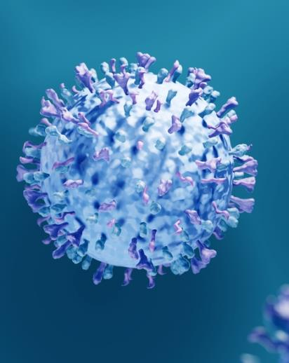
Respiratory Syncytial Virus (RSV)
Common respiratory virus usually causes mild, cold-like symptoms
RSV infections can be dangerous for adults
Adults at highest risk for severe infection:
  Elderly
  Chronic heart or lung disease
  Weakened immune systems
  Living in LTC facilities
CDC: Respiratory Syncytial Virus RSV
Notes:
Respiratory syncytial (sin-SISH-hull) virus, or RSV, is a common respiratory virus that usually causes mild, cold-like symptoms. Most people recover in a week or two, but RSV can be serious. Infants and older adults are more likely to develop severe RSV and need hospitalization. Vaccines are available to protect older adults from severe RSV. Monoclonal antibody products are available to protect infants and young children from severe RSV. RSV can also cause more severe infections such as bronchiolitis, an inflammation of the small airways in the lung, and pneumonia, an infection of the lungs.
RSV infections can be dangerous for certain adults. Each year, it is estimated that between 60,000-160,000 older adults in the United States are hospitalized and 6,000-10,000 die due to RSV infection. Adults at highest risk for severe RSV infection include:
Older adults
Adults with chronic heart or lung disease
Adults with weakened immune systems
Adults with certain other underlying medical conditions
Adults living in nursing homes or long-term care facilities

Slide 33
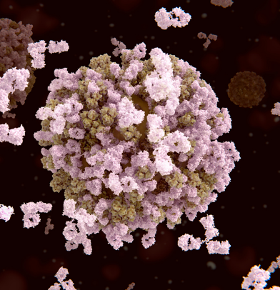
Norovirus
Highly contagious virus in the Caliciviridae family
Leading cause of foodborne illness, vomiting and diarrhea in the US
Many different types of norovirus
Sometimes called “stomach flu”
Can occur anytime in the year but more common from November to April
Bradley, CDC
Notes:
Norovirus is a group of highly contagious viruses that cause vomiting and diarrhea. Norovirus is the leading cause of vomiting and diarrhea, and foodborne illness in the United States. People of all ages can get infected and sick with norovirus, which spreads very easily and quickly. Anyone can get infected and sick with norovirus. Norovirus is sometimes called the “stomach flu” or “stomach bug”. However, norovirus illness is not related to the flu, which is caused by influenza virus.
You can get norovirus illness many times in your life because there are many different types of noroviruses. Infection with one type of norovirus may not protect you against other types. It is possible to develop protection against specific types. But, it is not known exactly how long protection lasts. This may explain why so many people of all ages get infected during norovirus outbreaks.
Although you can get norovirus illness at any time during the year…
Most norovirus outbreaks in the United States happen from November to April and as you can see, in Pennsylvania this is true.
During the month of November, more norovirus suspected by Kaplan criteria have been reported in long-term care facilities.

Slide 34
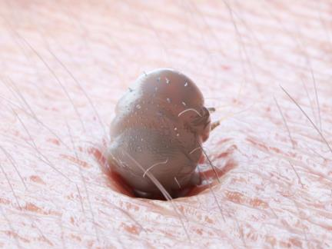
Scabies
Skin infestation by the mite Sarcoptes scabiei
Mites burrow into the skin, lives and lays eggs
Spreads rapidly in crowded conditions
Burrows can sometimes be seen on skin
  Caused by female scabies tunneling just beneath surface to lay eggs
Bradley, CDC
Notes:
Scabies is an infestation of the skin by the human itch mite (Sarcoptes scabiei var. hominis). The microscopic scabies mite burrows into the upper layer of the skin where it lives and lays its eggs. The most common symptoms of scabies are intense itching and a pimple-like skin rash. The scabies mite usually is spread by direct, prolonged, skin-to-skin contact with a person who has scabies.
Scabies is found worldwide and affects people of all races and social classes. Scabies can spread rapidly under crowded conditions where close body and skin contact is frequent. Institutions such as nursing homes, extended-care facilities, and prisons are often sites of scabies outbreaks. Child-care facilities also are a common site of scabies infestations.
Tiny burrows sometimes are seen on the skin; these are caused by the female scabies mite tunneling just beneath the surface of the skin. These burrows appear as tiny raised and crooked (serpiginous) grayish-white or skin-colored lines on the skin surface. Because mites are often few in number (only 10-15 mites per person), these burrows may be difficult to find. They are found most often in the webbing between the fingers, in the skin folds on the wrist, elbow, or knee, and on the penis, breast, or shoulder blades

Slide 35
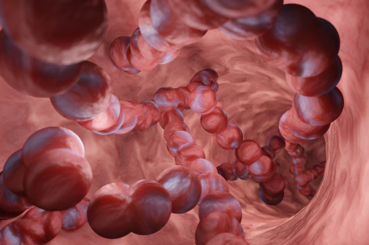
Invasive Group A Streptococcus (iGAS)
Also known as Streptococcus pyogenes or group A strep (GAS)
Commonly found in the mouth, nose, and on the skin
Very contagious, spread easily person to person
Can be colonized or actively infected
Very young, elderly, pregnant women, immunocompromised people most at risk
Outbreaks common in LTC facilities
Adkins, APIC
Notes:
What are group A streptococcal infections?
Yes, GAS bacteria are very contagious. This bacterium can affect anyone, because it spreads easily from person to person. The risk of spread is greatest when a person is ill, for example, with a strep throat or an infected wound.
Group A Streptococcus is also known as Streptococcus pyogenes or “group A strep (GAS)”
GAS colonization – Occurs when group A strep bacteria live on your skin and in your throat and are not causing any signs or symptoms of an illness.
GAS infection – When these bacteria invade through a break in the skin or throat and multiply.
Invasive GAS infection (iGAS) – Occurs when the bacteria invade internal parts of the body, such as the bloodstream, heart, joints, and other vital organs.
Why should I be concerned about GAS infections?
These bacteria can be transmitted to others by a person who is colonized or infected.
GAS infections are usually mild and treatable in the beginning, but medical care is needed to prevent serious illness, organ failure, or in some cases, death.
There has been a recent increase in the number of iGAS infections in children in the United States.
GAS infections can be dangerous for young children, the elderly, people who are pregnant, or people who have immunocompromised conditions.
Outbreaks are most common in long-term care facilities. Residents in these facilities are at greater risk for severe infection and death from GAS infections versus adults in the community.
If you suspect you, your child, or a loved one has a GAS infection, get medical treatment as soon as possible to prevent serious illness.

Slide 36
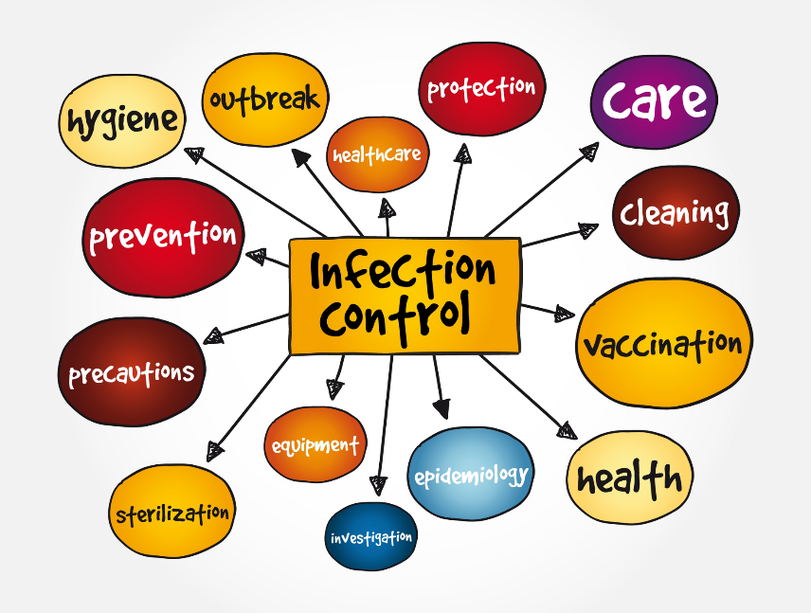
Notes:
Infection prevention & control is not about policies written in a manual. It is about what we all do everyday at work to prevent harm and enhance safety! Our job is to PREVENT INFECTIONS…. NOT JUST CONTROL THEM!
There are 3 principle goals of infection prevention programs.
Protect the resident
Protect HCP, visitors, and others in the healthcare environment
Accomplish these 2 previous goals in a cost-effective manner when possible.

Slide 37
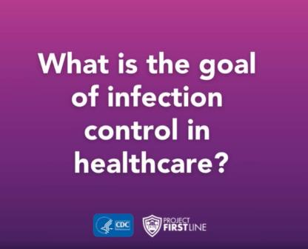
Principal Goals of Infection Prevention
Protect the resident
Protect others in the healthcare facility
Cost-effective
(APIC)
Notes:
3 principle goals of infection prevention programs.
Protect the patient
Protect HCP, visitors, and others in the healthcare environment
Accomplish these 2 previous goals in a cost-effective manner when possible.

Slide 38

Infection Prevention in Long-Term Care
Unique challenges:
  Regulations
  Expectations
  Environment
Requires creative problem-solving
(APIC)
Notes:
Protecting residents and staff from infections and harm is a basic standard of care.
Infection prevention should be understood and best practices followed by all members of your care team.
Residents are at increased risk of infection and LTC need to balance prevention of possible disease transmission versus consequences of social isolation.

Slide 39
Key Concepts
“Residents in long-term care facilities (LTCF) are at increased risk of infection because of congregate living, staffing turnover, dependence on unlicensed caregivers, blunted immune responses, and an increased use of invasive devices.”
The Centers for Medicare & Medicaid Services (CMS) requires LTCF to provide a “home-like environment” and “person-centered care.”
LTCF needs to provide a safe environment for all residents:
  Free from infections
  Free from exposure to communicable diseases
  Opportunity to engage in social activities for their psychosocial well-being
(APIC, CMS)

Slide 40
Importance of Early Recognition
Can lead to better treatment outcomes
Can prevent the disease from progressing
Allows for early implementation of precautions to help prevent transmission and limit spread
Reduces the risk of transmission of infections between residents, healthcare workers and others in the healthcare environment.
Surveillance is necessary to identify potential infections to help control transmission
(APIC)
Notes:
Early detection of infectious diseases plays a crucial role in all treatment and prevention strategies.
Advantages of early detection -
can lead to better treatment outcomes, as the disease may be in its initial stages, making it more responsive to treatment. Early detection and treatment can also prevent the disease from progressing, reducing the risk of complications and improving long-term health.
Limiting outbreak size
Constant surveillance is necessary to identify potential infections

Slide 41
Minimize the Exposure!
Chain of transmission
Hand hygiene
Standard Precautions
Transmission-based Precautions
Enhanced Barrier Precautions
(APIC)

Slide 42
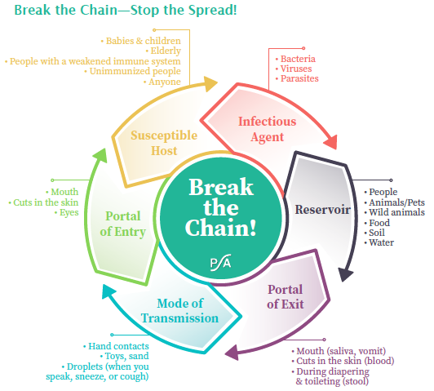
Chain of Transmission
Notes:
The diagram represents the “chain” or cycle of transmission of an infection. Many different pathogens (“germs”) are found inside and outside a healthcare facility. These germs spread from one person to another through a common series of events: the “chain of transmission.” Breaking the chain at any point in the cycle prevents the germ from infecting more people.1 The links of the chain include1
• Infectious Agent—germ that causes disease
• Reservoir—where the germ lives (people, equipment, vectors such as ticks, or mosquitoes)
• Portal of Exit—how the germ leaves the reservoir (coughing, sneezing, body fluids)
• Mode of Transmission—how the germ is passed on (direct or indirect contact, fomites, ingestion, inhalation)
• Portal of Entry—how the germ enters the new host (mucous membranes, respiratory tract, broken skin, gastrointestinal tract, catheters)
• Susceptible Host—can be anyone, but having recent surgery, burns, diabetes, immunosuppression, cardiopulmonary disease, or indwelling devices such
as Foley catheters makes someone more susceptible
The way to stop germs from spreading is by breaking or interrupting this chain at any link. Ways to break the chain include frequent hand hygiene, vaccination (including COVID or influenza—“flu shot”), cough and sneeze etiquette, following the rules for Standard and Contact Precautions, using personal protective equipment (PPE) the right way, cleaning and disinfecting the environment, sterilizing medical instruments and equipment, following safe injection practices, and using antibiotics wisely to prevent antibiotic resistance. Long-term care infection prevention tools for residents and visitors are available from the Association for Professionals in Infection Control and Epidemiology

Slide 43

Hand Hygiene
Notes:
The most effective way to prevent the spread of infection!
oWhen to perform HH
Before:
Having contact with residents
Putting on gloves
Inserting an invasive device
Manipulating an invasive device
After:
Having contact with a resident’s skin
Having contact with body fluids/excretions, non-intact skin, wound dressings, contaminated items
Having contact with inanimate objects near a resident
Removing gloves
Are staff being educated and audited for HH compliance?
Keep natural fingernails short, no longer than ¼ inch.
Do not wear artificial nails when having direct contact with high-risk residents.
Refer to your facility-specific policy.

Slide 44
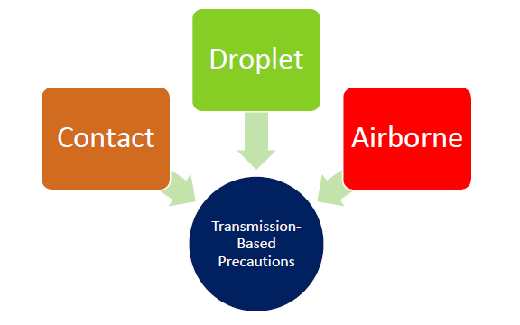
Types of Precautions
Standard
Transmission-based:
  Contact
  Droplet
  Airborne
Enhanced Barrier
Notes:
Standard precautions
Transmission‐Based Precautions are for patients who are known or suspected to be infected or colonized with infectious agents, including certain epidemiologically important pathogens, and are used when the route(s) of transmission are not completely interrupted using Standard Precautions alone.

Slide 45
Standard Precautions
The minimum infection prevention measures that apply to all resident care, regardless of suspected or confirmed infection status of the resident
Evidence-based practices designed to protect healthcare personnel and prevent the spread of infections among residents
Implementation of Standard Precautions constitutes the primary strategy for the prevention of healthcare-associated transmission of infectious agents among residents and healthcare personnel
(CDC)
Notes:
Read slide
Hand hygiene
Use of personal protective equipment (PPE)
Safe handling of potentially contaminated equipment or surfaces in the patient environment
Respiratory hygiene/cough etiquette
Safe injection practices
“Dress for the occasion” If you anticipate the chance of being splashed, splattered, or contaminated in any way by the job you are about to perform…
PPE is required.
Gloves are worn if potential contact with blood or body fluid, mucous membranes, or non-intact skin;
Gloves are changed and hand hygiene is performed before moving from a contaminated body site to a clean body site during resident care;
A gown is worn for direct resident contact if the resident has uncontained secretions or excretions;
A facemask is worn if contact (i.e., within 3 feet) with a resident with new acute cough or symptoms of a respiratory infection (e.g., influenza-like illness);
Appropriate mouth, nose, and eye protection (e.g., facemasks, face shield) is worn for performing aerosol-generating and/or procedures that are likely to generate splashes or sprays of blood or body fluids.

Slide 46
Standard Precautions Include:
Hand hygiene
Use of personal protective equipment (PPE)
Safe handling of potentially contaminated equipment or surfaces in the patient environment
Respiratory hygiene/cough etiquette
Safe injection practices
(CDC-2007 Isolation)

Slide 47
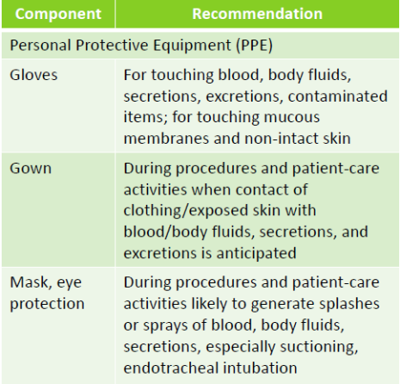
Resident Characteristics
Cognitive function (understands directions)
Cooperative (willing and able to follow directions)
Continent (of urine or stool)
Contained (secretions, excretions, or wounds)
Cleanliness (capacity for personal hygiene)
(CDC, Kellar)
Notes:
Kellar M. APIC Infection Connection. Fall 2010 ed.
Resident characteristics help determine if standard precautions will be effective in preventing the spread of pathogens. Read slide
Gloves are worn if potential contact with blood or body fluid, mucous membranes, or non-intact skin;
Gloves are changed and hand hygiene is performed before moving from a contaminated body site to a clean body site during resident care;
A gown is worn for direct resident contact if the resident has uncontained secretions or excretions;
A facemask is worn if contact (i.e., within 3 feet) with a resident with new acute cough or symptoms of a respiratory infection (e.g., influenza-like illness);
Appropriate mouth, nose, and eye protection (e.g., facemasks, face shield) is worn for performing aerosol-generating and/or procedures that are likely to generate splashes or sprays of blood or body fluids.
The table lists what PPE is recommended for certain tasks/hazards

Slide 48
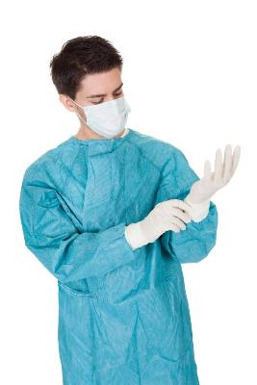
“Dress for the Occasion”
If you anticipate the chance of being splashed, splattered, or contaminated in any way by the job you are about to perform…
PPE is required.
(CDC-2007 Isolation)
Notes:
Gloves are worn if potential contact with blood or body fluid, mucous membranes, or non-intact skin;
Gloves are changed and hand hygiene is performed before moving from a contaminated body site to a clean body site during resident care;
A gown is worn for direct resident contact if the resident has uncontained secretions or excretions;
A facemask is worn if contact (i.e., within 3 feet) with a resident with new acute cough or symptoms of a respiratory infection (e.g., influenza-like illness);
Appropriate mouth, nose, and eye protection (e.g., facemasks, face shield) is worn for performing aerosol-generating and/or procedures that are likely to generate splashes or sprays of blood or body fluids.

Slide 49
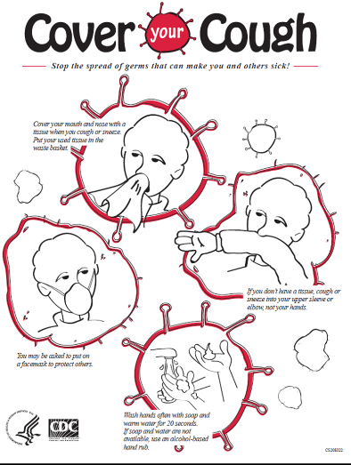
Good Cough Etiquette
Cover your mouth and nose with a tissue when you cough or sneeze.
Put your used tissue in the waste basket.
If you don’t have a tissue, cough or sneeze into your upper sleeve or elbow, not your hands. Perform hand hygiene
Put on a facemask to protect others.
(CDC-Influenza)
Notes:
Not up your sleeve and “dab it”

Slide 50
Transmission-Based Precautions
Guideline for Isolation Precautions: Preventing Transmission of Infectious Agents in Healthcare Settings (2007):
  Example of Safe Donning and Removal of PPE
  Type and Duration of Precautions Recommended for Selected Infections and Conditions
Contact Precautions:
  Multidrug-resistant organisms
  Norovirus
  Scabies
Droplet Precautions:
  Influenza
  RSV
  COVID-19
Airborne Precautions:
  COVID-19 if performing the aerosolizing procedure (suctioning, trach care, etc.)
  Measles, Tuberculosis, Chickenpox, Disseminated shingles
Notes:
Last update: September 2018

Slide 51
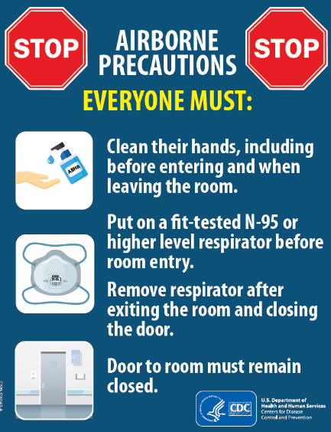
Airborne Precautions
Used for residents known or suspected to be infected with pathogens transmitted by the airborne route, such as TB, SARS, measles, chickenpox, and disseminated herpes zoster.
Door must remain closed!
(APIC, CDC)
Notes:
Negative Air Room, door closed.
PPE outside room
Masks – N95 respirator mask or PAPR
If patient must leave room, patient must wear surgical mask
Must be fit tested

Slide 52

Airborne Precautions
Airborne infection isolation room (AIIR) with the door closed
Post signage outside the room
PPE outside room
Masks – N95 respirator mask or PAPR
Don mask before room entry and doff after leaving room
Limit transport outside the room to medically necessary reasons only
If resident must leave the room, they must wear a surgical mask
Staff must be fit-tested
If AIIR is not available, mask resident with a surgical mask and place them in a private room with the door closed until transferred to a facility with a negative air room
(APIC, CDC)
Notes:
Source control: put a mask on the patient.
Ensure appropriate patient placement in an airborne infection isolation room (AIIR) constructed according to the Guideline for Isolation Precautions. In settings where Airborne Precautions cannot be implemented due to limited engineering resources, masking the patient and placing the patient in a private room with the door closed will reduce the likelihood of airborne transmission until the patient is either transferred to a facility with an AIIR or returned home.
Restrict susceptible healthcare personnel from entering the room of patients known or suspected to have measles, chickenpox, disseminated zoster, or smallpox if other immune healthcare personnel are available.
Use personal protective equipment (PPE) appropriately, including a fit-tested NIOSH-approved N95 or higher level respirator for healthcare personnel.
Limit transport and movement of patients outside of the room to medically-necessary purposes. If transport or movement outside an AIIR is necessary, instruct patients to wear a surgical mask, if possible, and observe Respiratory Hygiene/Cough Etiquette. Healthcare personnel transporting patients who are on Airborne Precautions do not need to wear a mask or respirator during transport if the patient is wearing a mask and infectious skin lesions are covered.
Immunize susceptible persons as soon as possible following unprotected contact with vaccine-preventable infections (e.g., measles, varicella or smallpox).

Slide 53
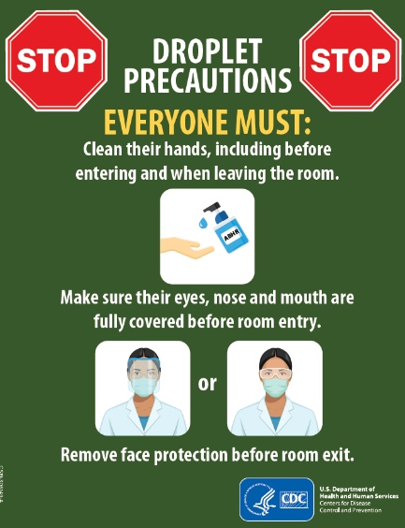
Droplet Precautions
Used for residents with known or suspected infection with pathogens transmitted by respiratory droplets such as influenza, meningitis, mumps, COVID-19*
Required PPE: Surgical mask, gloves, and eye protection when working closely with the resident (within 3-6 feet)
*NOISH-approved N95 or equivalent or higher-level respirator always recommended for COVID-19
(APIC, CDC)
Notes:
Use Droplet Precautions for patients known or suspected to be infected with pathogens transmitted by respiratory droplets that are generated by a patient who is coughing, sneezing, or talking

Slide 54

Droplet Precautions
Ensure appropriate room placement
Hand hygiene on entry and exit from the room
Don mask upon entry to the room
Limit transport of resident outside of the room for medically necessary reasons
If resident must leave the room, they must wear masks and follow Respiratory Hygiene/Cough Etiquette
(APIC, CDC)
Notes:
Source control: put a mask on the patient.
Ensure appropriate patient placement in a single room if possible. In acute care hospitals, if single rooms are not available, utilize the recommendations for alternative patient placement considerations in the Guideline for Isolation Precautions. In long-term care and other residential settings, make decisions regarding patient placement on a case-by-case basis considering infection risks to other patients in the room and available alternatives. In ambulatory settings, place patients who require Droplet Precautions in an exam room or cubicle as soon as possible and instruct patients to follow Respiratory Hygiene/Cough Etiquette recommendations.
Use personal protective equipment (PPE) appropriately. Don mask upon entry into the patient room or patient space.
Limit transport and movement of patients outside of the room to medically-necessary purposes. If transport or movement outside of the room is necessary, instruct patient to wear a mask and follow Respiratory Hygiene/Cough Etiquette.

Slide 55
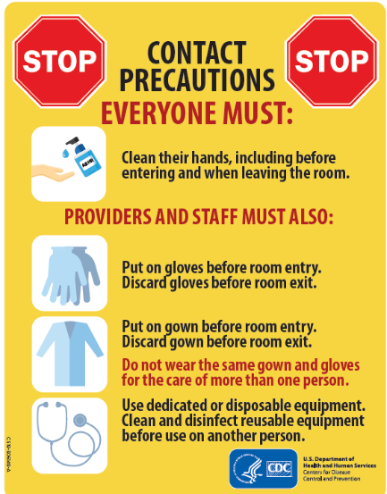
Contact Precautions
Used for multidrug-resistant organisms, C. difficile, norovirus, scabies, and shingles in immunocompromised residents and vesicles cannot be covered
All residents with an MDRO when there is acute diarrhea, draining wounds, or other sites of secretions/excretions that cannot be contained or covered
On units or in facilities where ongoing transmission is documented or suspected
Other conditions as noted in Appendix A‐ Type and Duration of Precautions Recommended
(APIC, CDC)
Notes:
•Used for residents that have an infection that can be spread by contact with the person’s skin, mucous membranes, feces, vomit, urine, wound drainage, or other body fluids, or by contact with equipment or environmental surfaces that may be contaminated by the patient/resident or by his/her secretions and excretions.
Examples of infections/conditions that require contact precautions: C. difficile, scabies, Salmonella,
In addition to standard precautions:
◦Wear a gown and gloves upon room entry of a patient/resident on contact precautions.
◦Use disposable single-use or patient/resident-dedicated noncritical care equipment (such as blood pressure cuffs and stethoscopes).
For certain organisms likely to have spores (like Clostridium difficile) and some disease with ongoing transmission (like Norovirus), “special” contact precautions are needed. In addition to the measures above, perform hand hygiene using soap and water and consider use of a hypochlorite solution (e.g., bleach) for environmental cleaning.
All residents with an MDRO when there is acute diarrhea, draining wounds or other sites of secretions/excretions that cannot be contained or covered
On units or in facilities where ongoing transmission is documented or suspected C. difficile infection
Norovirus
Shingles when resident is immunocompromised, and vesicles cannot be covered
Other conditions as noted in Appendix A‐ Type and Duration of Precautions Recommended For Selected Infections and Conditions

Slide 56

Contact Precautions
Hand hygiene before donning and after doffing gloves
Gown and gloves upon ANY room entry
Dedicated equipment to the room
Clean and disinfect any equipment before leaving the room
Room restriction except for medically necessary care
Prioritize environmental cleaning with a focus on high-touch areas
(APIC, CDC)
Notes:
Ensure appropriate patient placement in a single patient space or room if available in acute care hospitals. In long-term and other residential settings, make room placement decisions balancing risks to other patients. In ambulatory settings, place patients requiring contact precautions in an exam room or cubicle as soon as possible.
Use personal protective equipment (PPE) appropriately, including gloves and gown. Wear a gown and gloves for all interactions that may involve contact with the patient or the patient’s environment. Donning PPE upon room entry and properly discarding before exiting the patient room is done to contain pathogens.
Limit transport and movement of patients outside of the room to medically-necessary purposes. When transport or movement is necessary, cover or contain the infected or colonized areas of the patient’s body. Remove and dispose of contaminated PPE and perform hand hygiene prior to transporting patients on Contact Precautions. Don clean PPE to handle the patient at the transport location.
Use disposable or dedicated patient-care equipment (e.g., blood pressure cuffs). If common use of equipment for multiple patients is unavoidable, clean and disinfect such equipment before use on another patient.
Prioritize cleaning and disinfection of the rooms of patients on contact precautions ensuring rooms are frequently cleaned and disinfected (e.g., at least daily or prior to use by another patient if outpatient setting) focusing on frequently-touched surfaces and equipment in the immediate vicinity of the patient.

Slide 57
Contact Precautions
Post clear signage outside the room
PPE available outside the room
Ensure access to alcohol-based hand rub
Trash can for PPE disposal
Monitor compliance
Provide education to residents, family, and visitors
Adherence to other measures including hand hygiene, environmental cleaning, and cleaning and disinfection of medical devices
(APIC, CDC)
Notes:
Contact or Enhanced Barrier Precautions: Post clear signage on the door or wall outside the room Make PPE available immediately outside the room Ensure access to alcohol‐based hand rub in every resident room (ideally inside and outside) Trash can available for PPE disposal Periodic monitoring and assessment of compliance Provide education to residents, family and visitors Adherence to other measures including hand hygiene, environmental cleaning and cleaning, disinfection of medical devices

Slide 58
Dealing With Multi-Drug Resistant Organisms
Facilities need balance :
  prevention of possible disease transmission
  consequences of social isolation.
Individually assess each resident for risk factors and use the least restrictive approach:
  Wounds
  Indwelling devices
  Ability to contain secretions
  Ability to follow instructions
  Behaviors
  Personal hygiene
(APIC)

Slide 59

What is Cohorting?
Grouping residents infected or colonized with the same infectious agent together to confine their care to one area
Grouping healthcare personnel to a cohort of residents
(APIC)
Notes:
According to the CDC, cohorting refers to the practice of grouping residents infected or colonized with the same infectious agent together to confine their care to one area and prevent contact with susceptible individuals.
Another element of cohorting can apply to healthcare personnel. During outbreaks, healthcare personnel may be assigned to a cohort of residents to further limit opportunities for transmission of infectious pathogens.

Slide 60
Residents are at Increased MDRO Risk
Invasive medical devices
Improper use of antibiotics
Poor hand hygiene
Ineffective environment cleaning
Resident challenges – acuity, mentation, “stuff”
Congregate living
Staffing turnover
Dependence on unlicensed caregivers
Blunted immune responses
(APIC, CDC)

Slide 61
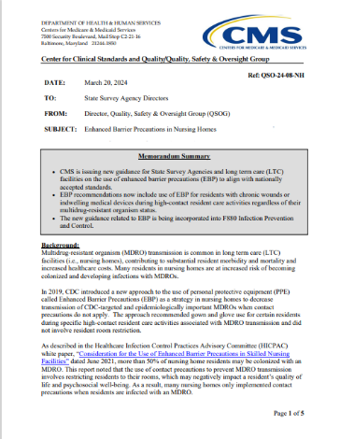
Regulation QSO-24-08-NH
Enhanced Barrier Precautions in Nursing Homes to Prevent Spread of Multidrug-resistant Organisms (MDROs)
Use of PPE for residents with targeted organisms, chronic wounds or indwelling medical devices during high-contact resident care activities
Incorporated into F880 Infection Prevention and Control
March 20, 2024
https://www.cms.gov/files/document/qso-24-08-nh.pdf
(CMS)
Notes:
Centers for Medicare and Medicaid (CMS) issued memo QSO-24-08-NH Enhanced Barrier Precautions in Nursing Homes to Prevent Spread of Multidrug-resistant Organisms (MDROs)
CMS is issuing new guidance for State Survey Agencies and long-term care (LTC) facilities on the use of enhanced barrier precautions (EBP) to align with nationally accepted standards.
• EBP recommendations now include use of EBP for residents with chronic wounds or indwelling medical devices during high-contact resident ca re activities regardless of their multidrug-resistant organism status.
• The new guidance related to EBP is being incorporated into F880 Infection Prevention and Control.
CMS is issuing new guidance for State Survey Agencies and long term care (LTC) facilities on the use of enhanced barrier precautions (EBP) to align with nationally
accepted standards.
• EBP recommendations now include use of EBP for residents with chronic wounds or
indwelling medical devices during high-contact resident care activities regardless of their
multidrug-resistant organism status.
• The new guidance related to EBP is being incorporated into F880 Infection Prevention
and Control.

Slide 62
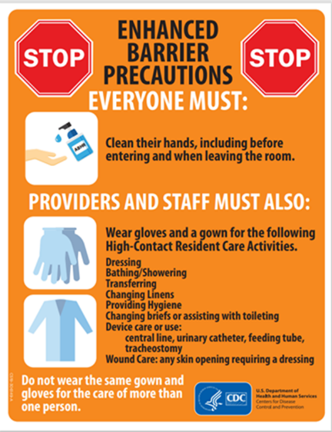
Enhanced Barrier Precautions
Bridge between Standard Precautions and Contact Precautions
Guidance is for LTC only.
Does not provide guidance for acute care or long-term acute care
Provides guidance for PPE use and room restriction for preventing transmission of novel or targeted MDROs
(CDC)
Notes:
Enhanced barrier precautions bridges between standard precautions and contact precautions when dealing with certain organisms (pan-resistant organisms, Candida auris and carbapenemase-producing organisms (Enterobacterales, Pseudomonas spp and Acinetobacter baumannii)
What this guidance DOES NOT do:
 Does not replace existing guidance regarding use of contact precautions for other pathogens (e.g., Clostridioides difficile, norovirus)
 Does not provide guidance for acute care or long‐term acute care (LTACs)
What this guidance DOES do:
 Does provide guidance for PPE use and room restriction in nursing homes for preventing transmission of novel or targeted MDROs, including as part of a
public health containment response
Activities
Dressing
Bathing/showering
Transferring
Providing hygiene
Changing linens
Changing briefs or assisting with toileting
Device care or use: central line, urinary catheter, feeding tube, tracheostomy/ventilator
Wound care: any skin opening requiring a dressing

Slide 63
What are Enhanced Barrier Precautions (EBPs)?
EBPs are designed to reduce the spread of multidrug resistant organisms (MDROs) by expanding the use of gloves and gowns during high contact resident care activities, especially for those at increased risk of acquiring or spreading a MDRO
Released in 2019 and updated in 2021 to include pathogens affecting every nursing home, such as Staphylococcus aureus
(CDC)
Notes:
EBPs are designed to reduce the spread of multidrug resistant organisms (MDROs) by expanding the use of gloves and gowns during high contact resident care activities, especially for those at increased risk of acquiring or spreading a MDRO
The Healthcare Infection Control Practices Advisory Committee (HICPAC) is a federal advisory committee chartered to provide advice and guidance to the Centers for Disease Control and Prevention (CDC) and the Secretary of the Department of Health and Human Services (HHS) regarding the practice of infection control and strategies for surveillance, prevention, and control of healthcare-associated infections, antimicrobial resistance and related events in United States healthcare settings. At the November 2019 HICPAC meeting, CDC asked HICPAC for input on topics related to the care of nursing home populations and the implementation and scope of Enhanced Barrier Precautions (EBP).
HICPAC formed a workgroup to develop this input. The Long-Term Care/Post-Acute Care (LTC/PAC) Workgroup provided updates and obtained HICPAC feedback at the November 2020, March 2021, and June 2021 HICPAC Meetings. At the June 2021 meeting, HICPAC voted to finalize the white paper based on expert opinion for broader use of EBP beyond targeted multidrug-resistant organisms, including pathogens that affect every nursing home in the United States such as S. aureus (both methicillin sensitive and resistant).
Executive Summary

Slide 64
Enhanced Barrier Precautions
Applies to all residents with any of the following:
  Wounds and/or indwelling medical devices regardless of MDRO colonization status regardless of MDRO colonization status
  Infection or colonization with a novel or targeted MDRO when Contact Precautions do not apply
  Facilities may consider applying to residents infected or colonized with other epidemiologically important MDROs
Use of gown and gloves during high-contact resident care activities that provide opportunities for transfer of MDRO to staff hands and clothing.
Residents are not restricted to their rooms or limited from participation in group activities.
(CDC)
Notes:
Applies to ALL residents with ANY of the following:
Wounds and/or indwelling medical devices (e.g., central lines, urinary catheter, feeding tube, tracheostomy/ventilator) REGARDLESS of MDRO colonization status (when a novel or targeted MDRO has been identified on the unit)
Infection OR colonization with a novel or targeted MDRO when Contact Precautions do not apply
Facilities may consider applying EBP to residents infected or colonized with other epidemiologically important MDROs based on facility policy (MRSA, VRE for example)
Gown and gloves prior to the high contact care activity (cannot reuse gown and change between residents)
No room restriction
The CDC tells us to expect the guidelines to expand. "Future updates are anticipated to address potential for application of this approach outside of a Containment Response." Some professionals are expecting the new precautions will replace our current Standard Precautions for all residents in the future.

Slide 65
Targeted & Clinically Significant Organisms
Targeted Organisms
Pan-resistant organisms,
Carbapenemase-producing carbapenem-resistant Enterobacterales,
Carbapenemase-producing carbapenem-resistant Pseudomonas,
Carbapenemase-producing carbapenem-resistant Acinetobacter baumannii, and
Candida auris
Clinically Significant Organisms
Methicillin-resistant Staphylococcus aureus (MRSA),
ESBL-producing Enterobacterales,
Vancomycin-resistant Enterococci (VRE),
Multidrug-resistant Pseudomonas aeruginosa,
Drug-resistant Streptococcus pneumoniae
(CDC)

Slide 66
High-Contact Resident Care Activities Requiring Gown and Glove Use
Dressing
Bathing/showering
Transferring
Providing hygiene
Changing linens
Changing briefs or assisting with toileting
Device care or use: central line, urinary catheter, feeding tube, tracheostomy/ventilator
Wound care: any skin opening requiring a dressing
Gown and gloves would not be required for resident care activities other than those listed above, unless otherwise necessary for adherence to Standard Precautions.
Residents are not restricted to their rooms or limited from participation in group activities
(APIC, CDC)

Slide 67
Enhanced Barrier Precautions
“Focusing only on residents with active infection fails to address the continued risk of transmission from residents with MDRO colonization, which can persist for long periods of time (e.g., months), and result in the silent spread of MDRO.”
Enhanced Barrier Precautions refer to the use of gowns and gloves during high-contact resident care activities that provide opportunities for transfer of MDRO to staff hands and clothing.
Residents are not restricted to their rooms or limited from participation in group activities.
Enhanced barrier precautions do not replace existing guidance regarding the use of Contact Precautions for other pathogens (e.g., C. difficile, norovirus, etc.) in nursing homes.
(CDC)
Notes:
In lower‐acuity post‐acute care settings (e.g., non‐ventilator units of skilled nursing facilities, rehabilitation facilities), the use of Contact Precautions is more challenging and should be guided by the potential risk that residents will serve as a source for additional transmission based on their functional and clinical status and the type of care activity that is being performed.
Expands the use of PPE beyond situations in which exposure to blood and body fluids is anticipated (i.e. Standard Precautions)
Refers to the use of gown and gloves during high‐contact resident care activities that provide opportunities for transfer of MDROs to staff hands and clothing
Pan-resistant organisms
Carbapenemase-producing enterobacteriaceae
Carbapenemase-producing Pseudomonas spp.
Carbapenemase-producing Acinetobacter baumannii
Candida auris

Slide 68
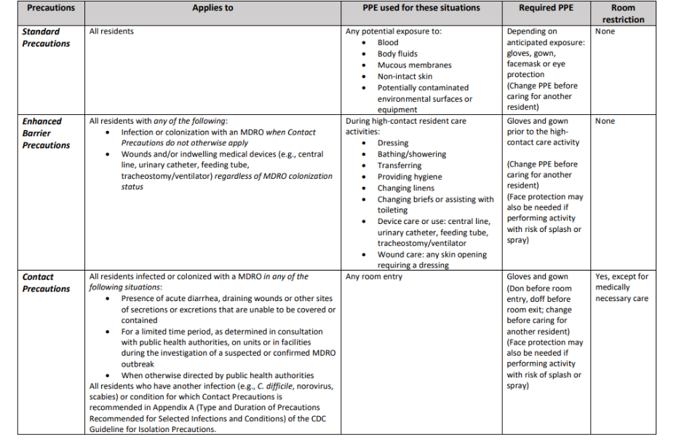
https://www.cdc.gov/hai/pdfs/containment/PPE-Nursing-Homes-Table-H.pdf
(CDC)
Notes:
Table: Summary of Personal Protective Equipment (PPE) Use and Room Restriction When Caring for Residents in Nursing Homes:

Slide 69
Health Insurance Portability and Accountability Act (HIPAA)
Precaution Signage:
  Signals the actions to be taken to protect the resident and person entering room
  Do not contain diagnosis or reason for the precautions
  Identifies the type of precautions and recommended PPE
  Does NOT violate Health Insurance Portability and Accountability Act (HIPAA) and resident dignity
  Generic “Speak to the nurse” signs are not adequate
(CDC)
Notes:
Does posting signs specifying the type of Precautions and recommended PPE outside the resident room violate Health Insurance Portability and Accountability Act (HIPAA) and resident dignity?
No. Signs are intended to signal to individuals entering the room the specific actions they should take to protect themselves and the resident. To do this effectively, the sign must contain information about the type of Precautions and the recommended PPE to be worn when caring for the resident. Generic signs that instruct individuals to speak to the nurse are not adequate to ensure Precautions are followed. Signs should not include information about the resident’s diagnosis or the reason for the Precautions (e.g., presence of a resistant pathogen); inclusion of that information would violate HIPAA and resident dignity.

Slide 70
Framework for Applying EBP
General considerations
Staff education and training with proof of competency
Develop a method to identify residents with wounds, indwelling devices, MDROs
Develop policies and procedures for EBP:
  Signage indicating required PPE and defining high-risk care activities
  PPE available outside of room
  Hand hygiene
  PPE disposal
Cost considerations
Optimize PPE supply:
  Bundle multiple care activities for the resident
  Identify potential overuse of PPE
  Consider washable cloth isolation gowns
(CDC)
Notes:
Framework for Applying Enhanced Barrier Precautions in Skilled Nursing Facilities
Implementation Approaches
General implementation considerations for EBP are available from the CDC.20 The application of EBP to routine care of residents with wounds or indwelling medical devices requires that staff participate in initial and on-going training on the facility’s expectations about hand hygiene and gown and glove use, along with proof of competency regarding appropriate use and donning and doffing technique for PPE. Facilities should develop a method to identify residents with wounds or indwelling medical devices, and post clear signage outside of resident rooms indicating the type of PPE required and defining high risk resident care activities. Gowns and gloves should be available outside of each resident room, and alcohol-based hand rub should be available for every resident room (ideally both inside and outside of the room). A trash can (or laundry bin, if applicable) large enough to dispose of multiple gowns should be available for each room. Facilities with rooms containing multiple residents should provide staff with training and resources to ensure that they change their gown and gloves and perform hand hygiene in between care of residents in the same room.
Cost Considerations
Implementation of routine EBP would incur costs including PPE (gowns/gloves), training, staff time to don and doff PPE, and signage materials. Potential savings would include avoidance of infections and hospitalizations. An economic analysis of a randomized controlled trial involving the use of EBP in a bundle to prevent catheter-associated urinary tract infections estimated net savings of approximately $15,000 per year per facility, but the savings would accrue to payers and not to skilled nursing facilities.21 Centers for Medicaid and Medicare and private insurers/commercial plans may need to consider the implementation and cost of EBP in payment models.
Considerations During Shortages of Gowns or Gloves
When PPE supply chains are strained during extraordinary circumstances such as the COVID-19 pandemic, facilities may encounter shortages of gowns or gloves. Neither extended use nor re-use of gowns and gloves is recommended for mitigating shortages in the context of EBP.
To optimize PPE supply, facilities can consider substituting disposable gowns with washable cloth isolation gowns that have long sleeves with cuffs. Healthcare personnel can reduce PPE consumption by bundling multiple care activities in the same resident interaction.
In addition, facilities can identify situations where PPE overuse is occurring. For example, staff may be overusing gloves to assist or care for residents who are not on transmission-based precautions to eat, during bed making, or when transporting bagged linen or trash. Dietary staff should be instructed to prioritize gloves for food handling but not for delivering or retrieving meal trays for residents who are not on transmission-based precautions, nor when transporting meal carts.
Lastly, when there are not enough gowns and gloves for implementation of EBP as recommended, facilities may temporarily prioritize EBP for residents with wounds over residents with indwelling medical devices alone. Risk of healthcare personnel self-contamination with S. aureus and MDROs is higher during care of residents with wounds, compared to residents with indwelling medical devices alone.12,13 Facilities implementing EBP based on a resident’s MDRO colonization or infection status may also prioritize EBP for novel or targeted MDROs over other MDROs.
Facilities should include procedures for PPE shortages in their emergency preparedness plan and/or facility assessment. During PPE shortages, facilities should document all actions taken to remedy the shortage.

Slide 71
Disposal of PPE
OSHA Bloodborne Pathogen Standard regulated waste requires biohazard disposal:
  Contaminated items that would release blood or infectious material if compressed
  Contaminated sharps
  Pathological or microbiological wastes
Most PPE used during resident care are not regulated waste and could be discarded in regular trash
Appropriate disposal container available to remove PPE inside the room
(CDC)
Notes:
You should refer to local and state regulations regarding disposal of medical waste. The OSHA Bloodborne Pathogen Standard uses the term “regulated waste” to refer to the following categories of waste which require special handling, at a minimum: liquid or semi-liquid blood or other potentially infectious materials (OPIM); contaminated items that would release blood or OPIM in a liquid or semi-liquid state if compressed; items that are caked with dried blood or OPIM and are capable of releasing these materials during handling; contaminated sharps; pathological and microbiological wastes containing blood or OPIM. Based on this definition, most PPE used during resident care, including care of residents placed in Enhanced Barrier or Transmission-Based Precautions, would not fall into the category of regulated medical waste requiring disposal in a biohazard bag, and could be discarded as routine non-infectious waste. Facilities should remember to have an appropriate disposal container available in the resident room to allow for removal of PPE inside the room. However, local or state regulations may be more restrictive than this federal standard, so you should refer to those when making decisions.

Slide 72
Summary
Infection prevention is everyone’s responsibility!
Protecting residents and staff from infections and harm is a basic standard of care.
Precautions should be understood and followed by all members of the care team.
Residents are at increased risk of infection and facilities need to provide a safe environment for all residents
CMS requires LTC to provide a “home-like environment” and “person-centered care.”
Leadership involvement is essential!
Use Transmission-based Precautions for residents with known or suspected infections or evidence of syndromes that represent an increased risk for contact transmission.
Enhanced Barrier Precautions apply to LTC and are reserved for novel or targeted MDRO
(APIC, CMS)
Notes:
“Residents in long-term care facilities (LTCF) are at increased risk of infection because of congregate living, staffing turnover, dependence on unlicensed caregivers, blunted immune responses, and an increased use of invasive devices.”
Centers for Medicare & Medicaid Services (CMS) requires LTCF to provide a “home-like environment” and “person-centered care.”
Infection prevention is everyone’s responsibility and a critical part of resident safety
Protecting residents and staff from infections and harm is a basic standard of care.
Precautions should be understood and followed by all members of your care team.
Residents are at increased risk of infection and facilities' need to balance prevention of possible disease transmission versus consequences of social isolation.
CMS requires LTC to provide a “home-like environment” and “person-centered care.”
Facilities need to provide a safe environment for all residents
Facilities need to provide a safe environment for all residents
free from infections
free from exposure to communicable diseases
opportunity to engage in social activities for their psychosocial well-being
Leadership involvement is essential!

Slide 73
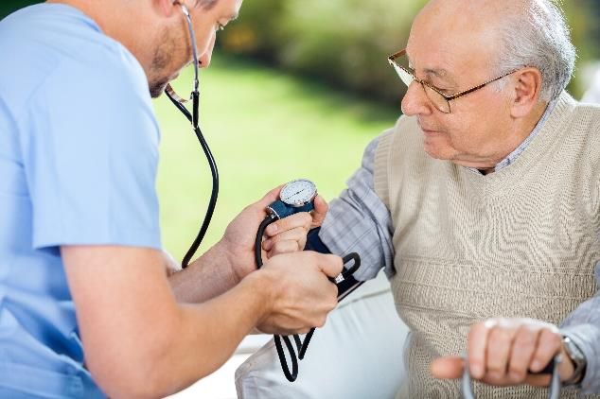
Infection Prevention Saves Lives
We do what we do for…
Our residents and their loved ones
Ourselves and our colleagues
Our loved ones

Slide 74




PSA Infection Prevention Advisors
JoAnn Adkins
joaadkins@pa.gov
717-756-0696
Christine Bingman
cbingman@pa.gov
570-492-2210
Amanda Bennett
amabennett@pa.gov
717-678-4744
Denise Cutting
dcutting@pa.gov
412-398-6373

Slide 75
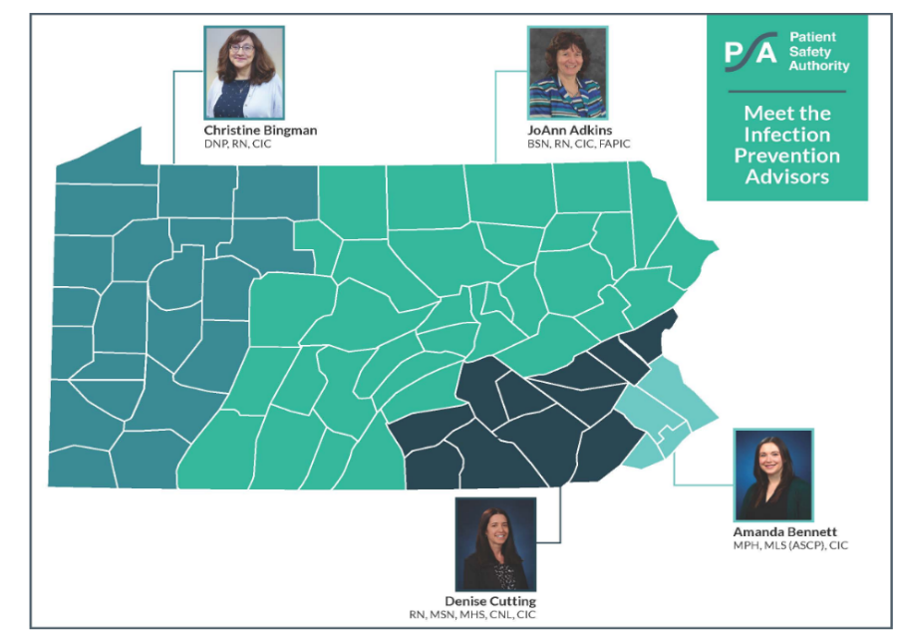

Slide 76
Resources
Infection Control Training Tools:
https://www.cdc.gov/longtermcare/training.html
https://spice.unc.edu/ltc/
Respiratory Protection Program:
https://www.cdc.gov/niosh/npptl/hospresptoolkit/programeval.html
https://www.ecdc.europa.eu/en/all-topics-z/coronavirus/threats-and-outbreaks/covid-19/prevention-and-control/LTCF-resources
Gap Analysis:
https://www.cms.gov/files/document/qso-20-03-nh.pdf
Surveillance:
https://www.apic.org/Resource_/TinyMceFileManager/Practice_Guidance/AJIC-Surveillance-2007.pdf

Slide 77
Resources
CDC Pre-Implementation Tool—Enhanced Barrier Precautions (EBP) https://www.cdc.gov/hai/pdfs/containment/Pre-Implementation-Tool-for-Enhanced-Barrier-Precautions-508.pdf
CDC Enhanced Barrier Precautions (EBP) Implementation—Observations Tool https://www.cdc.gov/hai/pdfs/containment/Observations-Tool-for-Enhanced-Barrier-Precautions-Implementation-508.pdf
CDC Enhanced Barrier Precautions Pocket Guide https://www.cdc.gov/hai/pdfs/containment/EBP-PocketGuide-508.pdf
CDC Implementation of Personal Protective Equipment (PPE) Use in Nursing Homes to Prevent Spread of Multidrug-resistant Organisms (MDROs) https://www.cdc.gov/hai/containment/PPE-Nursing-Homes.html

Slide 78
Resources
CDC Enhanced Barrier Precautions Letters:
  Residents, families, friends, and volunteers https://www.cdc.gov/hai/pdfs/containment/Letter-Nursing-Home-Residents-Families-Friends-508.pdf
  Staff https://www.cdc.gov/hai/pdfs/containment/Letter-Nursing-Home-Staff-508.pdf
  Leadership https://www.cdc.gov/hai/pdfs/containment/Enhanced-Barrier-Precautions-Letter-for-Nursing-Home-Leadership-508.pdf
Guideline for Isolation Precautions: Preventing Transmission of Infectious Agents in Healthcare Settings (2007):
  Example of Safe Donning and Removal of PPE
  Type and Duration of Precautions Recommended for Selected Infections and Conditions

Slide 79
Resources
CDC Posters:
  Enhanced Barrier Precautions Sign https://www.cdc.gov/hai/pdfs/containment/enhanced-barrier-precautions-sign-P.pdf
  How We Keep Our Residents Safe https://www.cdc.gov/hai/pdfs/containment/EBP-KeepResidentsSafe-Poster-508.pdf
  Enhanced Barrier Precautions (EBP) Steps https://www.cdc.gov/hai/pdfs/containment/EBP-MDROs-Poster-508.pdf

Slide 80
Resources
Enhanced Barrier Precautions:
https://www.cdc.gov/hai/pdfs/containment/enhanced-barrier-precautions-sign-P.pdf
https://www.cdc.gov/hai/containment/faqs.html
COVID-19 Enhanced Focus Survey:
https://www.cms.gov/Medicare/Provider-Enrollment-andCertification/GuidanceforLawsAndRegulations/Nursing-Homes
https://ahca.myflorida.com/docs/FHCACOVIDVisitorScreeningToolkit.pdf.
IP Training:
https://www.train.org/cdctrain/training_plan/3814
https://apic.org/education-and-events/ltc-certificate/

Slide 81
Resources
Risk Assessments:
https://qioprogram.org/facility-assessment-tool
https://www.cdc.gov/infectioncontrol/pdf/icar/ltcf.pdf
https://www.cdc.gov/coronavirus/2019-ncov/downloads/hcp/assessment-tool-nursinghomes.pdf
https://spice.unc.edu/resource/template-risk-assessment-for-ltc/
https://www.cdc.gov/coronavirus/2019-ncov/downloads/hcp/nursing-home-icar-facilitator-guide.pdf

Slide 82
Resources
Antibiotic Stewardship:
https://www.cdc.gov/getsmart/community/materials-references/print materials/hcp/viral-rx-pad-color.pdf
https://www.cdc.gov/antibiotic-use/community/pdfs/aaw/CDCAU_RCx_Relief_for_Viral_Illness_sm_v8_508.pdf
AHRQ Hand Hygiene Assessment Tool:
https://www.ahrq.gov/nursing-home/materials/prevention/hand-hygiene-observational-audits.html
Emergency Preparedness Resource Document
https://files.constantcontact.com/6d4c737e001/19cff006-d6f1-47a5-b60b-04fbae5bc4ab.pdf

Slide 84
References
Adkins, J. Data snapshot: group A streptococcus in Pennsylvania long-term facilities. Pa Patient Saf Advis [online] 2018 Mar. [online]. http://patientsafety.pa.gov/ADVISORIES/Pages/201803_iGAS.aspx
APIC (2014).Text of Infection Control and Epidemiology, 4th edition
Arnold FW, Antimicrobials and Resistance. In Boston K.M., et al, eds APIC Text. 2017. Available at https://text.apic.org/toc/microbiology-and-risk-factors-for-transmission/antimicrobials-and-resistance
Bradley, S. (2016). Norovirus Prevention: Tips from the Toolkit. Pennsylvania Patient Safety Authority, Jun;13(2):66-73
Bradley S. (2016). Scabies: Strategies for management and control. Pennsylvania Patient Safety Advisory, 13(2):66-73.
Burdsall D, Marx JF. Infection Prevention in Long‑Term Care. In: Infection Prevention Guide to Long-Term Care. 2nd ed. Arlington (VA): Association for Professionals in Infection Control and Epidemiology (APIC); 2019.
Centers for Disease Control and Prevention (CDC). Group A streptococcal disease. [online]. Available: https://www.cdc.gov/groupastrep/index.html
Centers for Disease Control and Prevention. (n.d.). How Antibiotic Resistance Moves Directly Germ to Germ. [online]. Accessed August 28, 2023. https://www.cdc.gov/drugresistance/pdf/threats-report/How-AR-Moves-508.pdf

Slide 85
References
Centers for Disease Control and Prevention. (2022). How Antibiotic Resistance Happens. Centers for Disease Control and Prevention. [online]. Accessed August 1, 2023. https://www.cdc.gov/drugresistance/about/how-resistance-happens.html
Centers for Disease Control and Prevention. (2021). National Estimates for Antibiotic Resistance. Centers for Disease Control and Prevention. [online] Accessed August 17, 2023. https://www.cdc.gov/drugresistance/national-estimates.html
Centers for Disease Control and Prevention. (n.d.). Select Germs Develop Antibiotic Resistance Over Time. [online]. Accessed August 17, 2023. https://www.cdc.gov/drugresistance/pdf/threats-report/Select-Germs-Develop-Resistance-Over-Time.pdf
Centers for Disease Control and Prevention. (2019). Antibiotic Resistance Threats in the United States, 2019. [online]. Accessed August 17, 2023. https://www.cdc.gov/drugresistance/pdf/threats-report/2019-ar-threats-report-508.pdf
Centers for Disease Control and Prevention (CDC). Scabies. Retrieved from https://www.cdc.gov/parasites/scabies/
Centers for Disease Control and Prevention. (2023). Influenza (flu). [online]. Accessed August 23, 2023. https://www.cdc.gov/flu/index.html

Slide 86
References
Centers for Disease Control and Prevention. (2023). COVID–19. [online]. Accessed August 24, 2023. https://www.cdc.gov/coronavirus/2019-ncov/index.html
Centers for Disease Control and Prevention. (2023). Respiratory syncytial virus (RSV). [online]. Accessed August 23, 2023. https://www.cdc.gov/rsv/index.html
Centers for Disease Control and Prevention. 2007 Guideline for Isolation Precautions: Preventing Transmission of Infectious Agents in Healthcare Settings [online]. [Cited 2019 Aug 6]. Available from the Internet: https://www.cdc.gov/hicpac/pdf/isolation/Isolation2007.pdf
Centers for Disease Control and Prevention. Implementation of Personal Protective Equipment in Nursing Homes to Prevent Spread of Novel or Targeted Multidrug-resistant Organisms (MDROs). Updated July 2019. [online]. [Cited 2019 Aug 6]. Available from the Internet: https://www.cdc.gov/hai/pdfs/containment/PPE-Nursing-Homes-H.pdf
Center for Medicare & Medicaid Services (CMS). Requirements of Participation Final Rule for Nursing Homes. Leading Age Provider Summary, September 2016. [online]. https://https://www.leadingage.org/sites/default/files/LeadingAge_CMS_Nursing_Home_Final_Rule_LeadingAge_Provider_Summary.pdf

Slide 87





Thank You!
Pennsylvania Patient
Safety Authority
@PAPatientSafety
Pennsylvania Patient
Safety Authority
Pennsylvania Patient
Safety Authority
@PatientSafetyAuthority

Slide 88

Contact Us
(717) 346-0469
patientsafetyauthority@pa.gov
patientsafety.pa.gov
^{Patient Safety Authority}
^{333 Market Street}
^{Lobby Level}
^{Harrisburg, PA 17101}

